Slide 1

Blockchain in PHP
Yes, we can!
Eligijus Stugys Senior Software Engineer NFQ Technologies eligijus.stugys@gmail.com www.stugys.lt

Slide 2
Examples
https://github.com/Eligijus1/Blockchain_in_PHP

Slide 3
History
1989 m. DigiCash Inc. - an electronic money corporation founded by David Chaum.
1998 m. DigiCash declared bankruptcy.
2009 m. BC released as open-source software by Satoshi Nakamoto (unknown person or persons group)
https://bitcoin.org/bitcoin.pdf

Slide 4
Intro to ElygaCoin
Reliable investment!
High growth potential!
Full security and anonymity

Slide 5
/ElygaCoin/1_money_core/index.php
<?php
$db = 'data/balance.json';
if (file_exists($db)) {
$balances = json_decode(file_get_contents($db), true);
} else {
$balances = ['Eligijus' => 1000000];
file_put_contents($db, json_encode($balances));
}
switch ($_SERVER['PATH_INFO']) {
case '/balance':
$user = $_GET['user'];
printf("User %s has %d ElygaCoin.", $user, $balances[$user] ?? 0);
break;
case '/user':
if ('POST' == $_SERVER['REQUEST_METHOD']) {
$user = $_POST['user'];
if (isset($balances[$user])) {
http_response_code(404);//Not Found
return;
}
$balances[$user] = 0;
file_put_contents($db, json_encode($balances));
print 'OK';

Slide 6
/ElygaCoin/1_money_core/index.php
case '/transfer':
if ('POST' == $_SERVER['REQUEST_METHOD']) {
$from = $_POST['from'];
$to = $_POST['to'];
if (!isset($balances[$from])) {
http_response_code(404);//Not Found
return;
}
if (!isset($balances[$to])) {
http_response_code(404);//Not Found
return;
}
$amount = (int)$_POST['amount'];
if ($amount > $balances[$from]) {
http_response_code(404);//Not Found
return;
}
$balances[$from] -= $amount;
$balances[$to] += $amount;
file_put_contents($db, json_encode($balances));
print 'OK';
} else {
print 'ERROR: Wrong request method.';
}
break;

Slide 7
/ElygaCoin/1_money_core/index.php
$ php -S localhost:8000 -t ./
$ wget -q -O - http://localhost:8000/balance?user=Eligijus
User Eligijus has 1000000 ElygaCoin.
$ wget -q -O - http://localhost:8000/balance?user=Petras
User Petras has 0 ElygaCoin.

Slide 8
/ElygaCoin/1_money_core/index.php
$ wget -q -O - http://localhost:8000/transfer --post-data "from=Eligijus&to=Petras&amount=5"
$ wget -q -O - http://localhost:8000/balance?user=Eligijus
User Eligijus has 999995 ElygaCoin.
$ wget -q -O - http://localhost:8000/balance?user=Petras
User Petras has 5 ElygaCoin.

Slide 9

Service must be always available
Availability

Slide 10
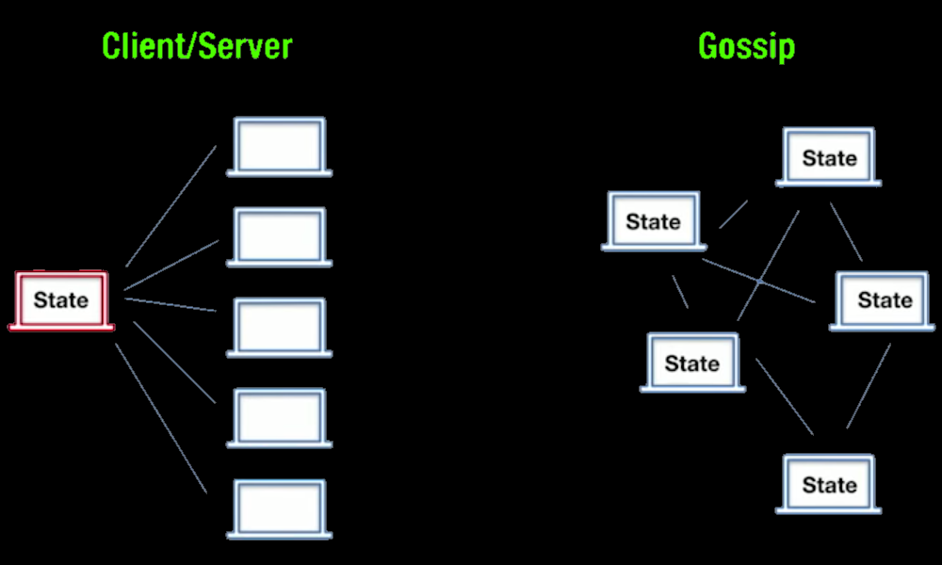
Solution: Availability through Decentralization

Slide 11
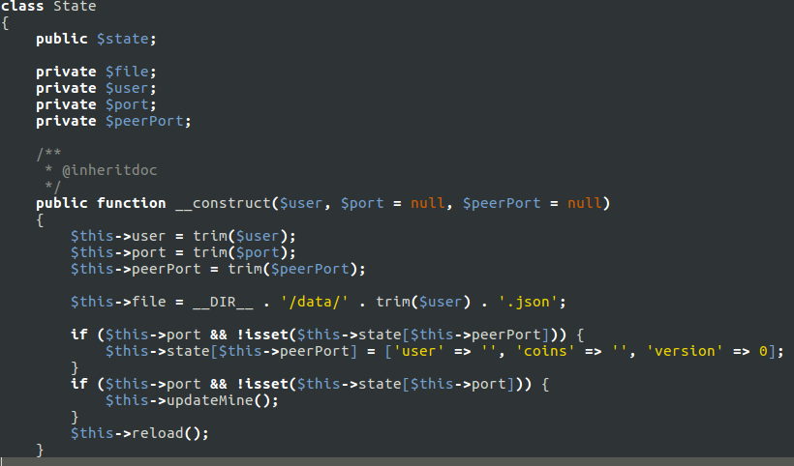
/ElygaCoin/2_gossip/State.php

Slide 12
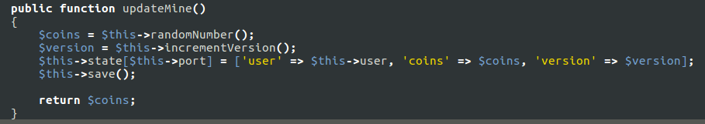
/ElygaCoin/2_gossip/State.php

Slide 13
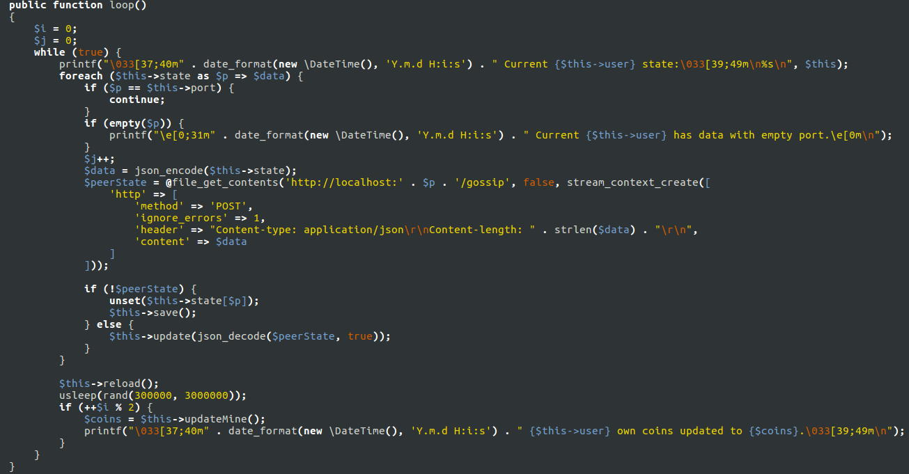
/ElygaCoin/2_gossip/State.php

Slide 14
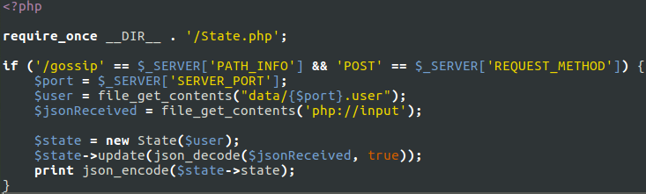
/ElygaCoin/2_gossip/index.php

Slide 15
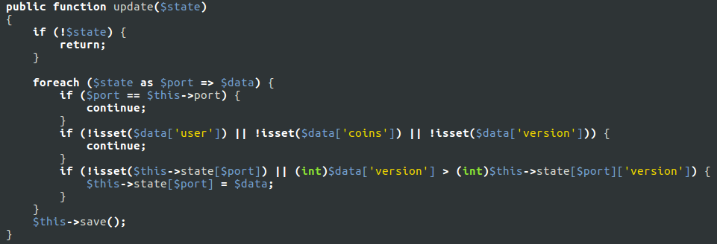
/ElygaCoin/2_gossip/State.php

Slide 16
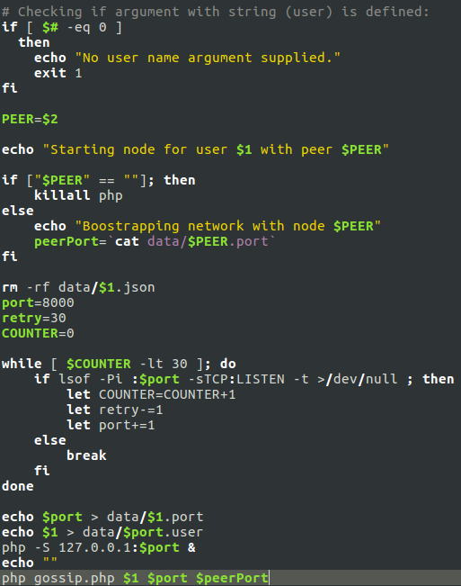
/ElygaCoin/2_gossip/gossip.sh

Slide 17
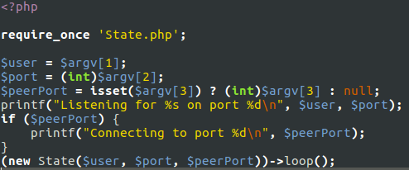
/ElygaCoin/2_gossip/gossip.php

Slide 18
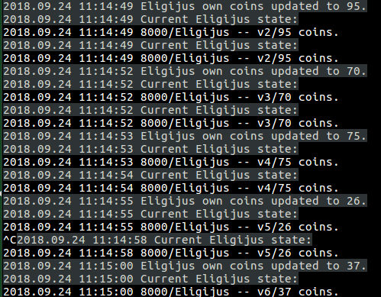
$ ./gossip.sh Eligijus

Slide 19
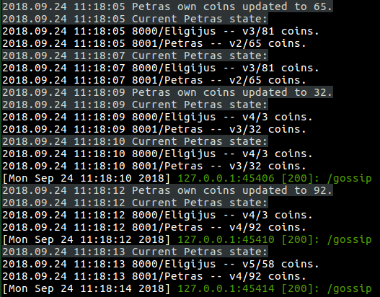
$ ./gossip.sh Petras Eligijus

Slide 20
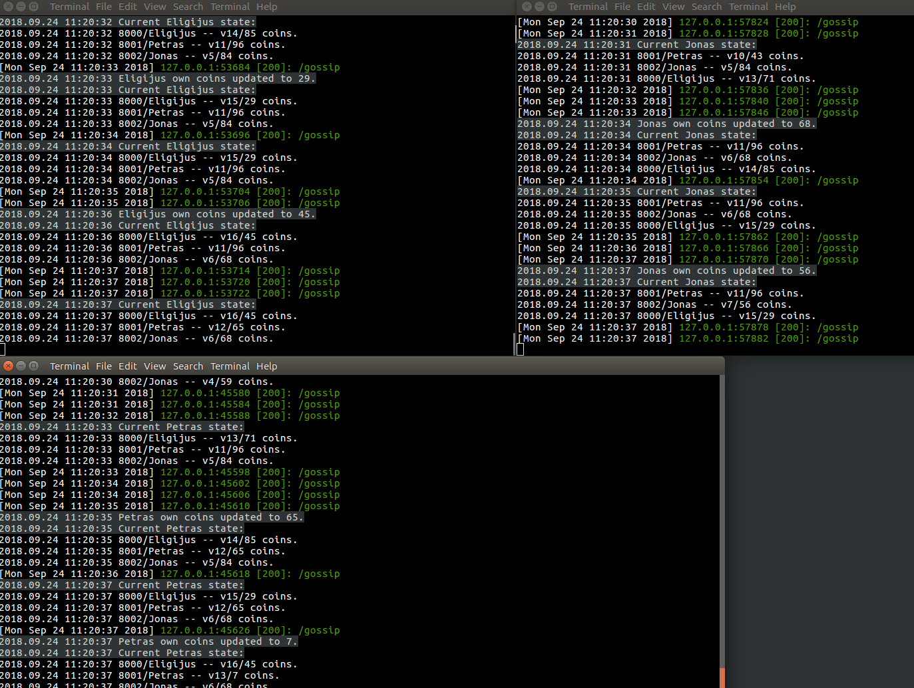
$ ./gossip.sh Jonas Petras

Slide 21
gossip introduces authentification problems
Availability
Authentification
User/Password not works !

Slide 22
Authentification through Cryptographic identities
Check is encrypted message with some user private key, can be decrypted with same user public key.

Slide 23
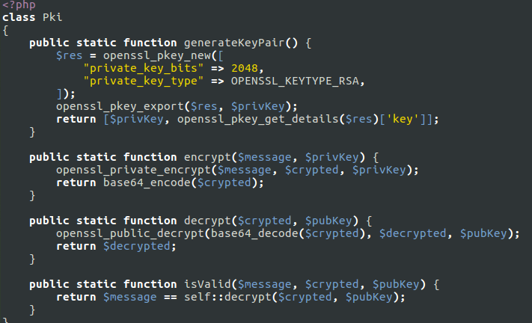
/ElygaCoin/3_pki/Pki.php

Slide 24
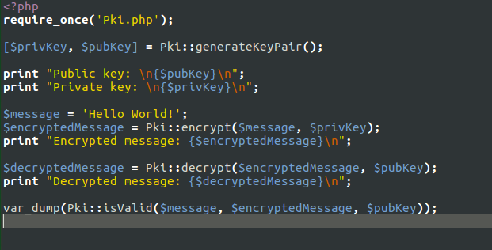
/ElygaCoin/3_pki/test_pki.php

Slide 25
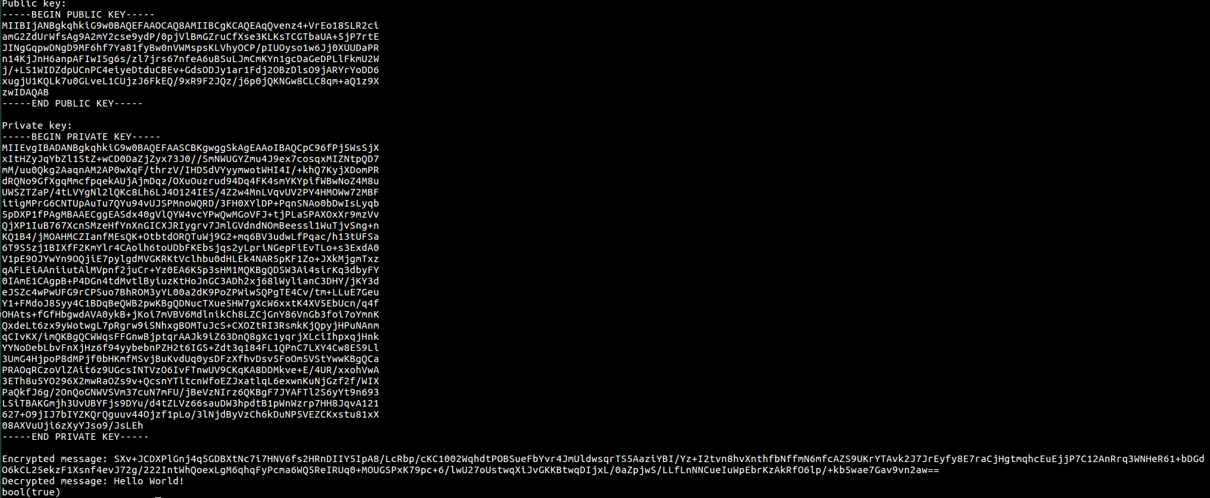
$ php test_pki.php

Slide 26
Peer-to-peer networks introduces Double-spend problems
Availability
Authentification
Double-spend
User can lie.
He can send 2 different messages.

Slide 27
Time agreement through Coordination
= Proof of Work
= Mining
= Find nonce
= Slow down transactions

Slide 28
/ElygaCoin/4_pow/
$ php -r '$start = microtime(true); echo hash("sha256", "Hello"); echo "\n" . (microtime(true) - $start) . "\n";'
185f8db32271fe25f561a6fc938b2e264306ec304eda518007d1764826381969
2.0980834960938E-5
$ php -r '$start = microtime(true); echo hash("sha256", "Hello1"); echo "\n" . (microtime(true) - $start) . "\n";'
948edbe7ede5aa7423476ae29dcd7d61e7711a071aea0d83698377effa896525
1.2874603271484E-5

Slide 29
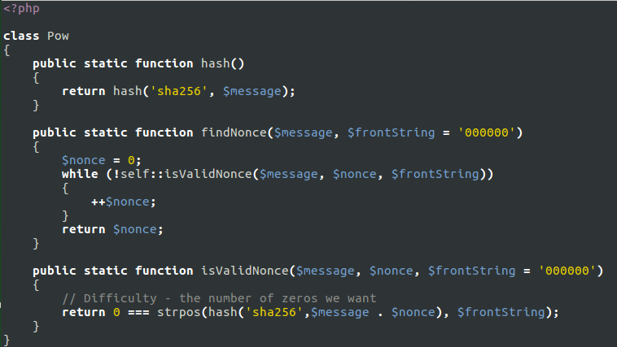
/ElygaCoin/4_pow/Pow.php

Slide 30
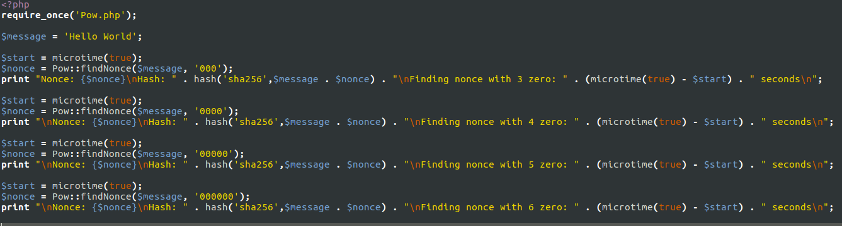
/ElygaCoin/4_pow/test_pow.php

Slide 31
$ php test_pow.php
Nonce: 656 Hash: 000c8ffe390708cfa23f6e9bce47dfb2fc28e7c6e2bebef9bed1858e1aea07cc Finding nonce with 3 zero: 0.0005340576171875 seconds Nonce: 107105 Hash: 0000bfe6af4232f78b0c8eba37a6ba6c17b9b8671473b0b82305880be077edd9 Finding nonce with 4 zero: 0.088746070861816 seconds Nonce: 616577 Hash: 00000efa601fff0c6b8c79c6a95031c69aa6f6f821c214316f26c6051a5275e7 Finding nonce with 5 zero: 0.49965190887451 seconds Nonce: 1439621 Hash: 0000008a53e365f8f4145f2cf4b502b29949b24746484ef2b556aaa5e2d7a562 Finding nonce with 6 zero: 1.2063858509064 seconds

Slide 32
Double-spend problems still not solved
Availability
Authentification
Double-spend
User now slow done, but still can do a double spend.
Now simple need more time.

Slide 33
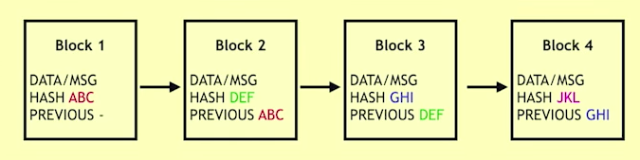
A blockchain
(linked list with hashes)
NOTE: if shuffle block, previous hash will be wrong.

Slide 34
Notice
A blockchain is a linked list with hashes
Blockchain solving only double-spend problem
Blockchain is not distributed DB

Slide 35
Fork choice rule
Availability
Authentification
Double-spend
Fork
Created 2 or more blocks, with same previous hash.

Slide 36
Always keep longest chain - fork choice rule
Because block creation takes time.
To fork at some point - need create longest chain.
To make longest chain, need have more CPU as rest of the network.
Before mining pools this was impossible...

Slide 37
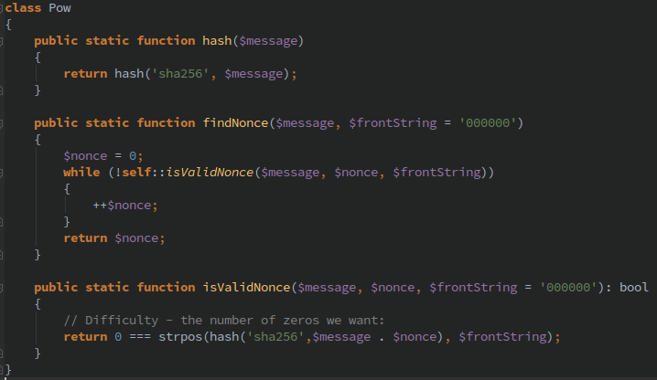
/ElygaCoin/5_blockchain/Pow.php

Slide 38
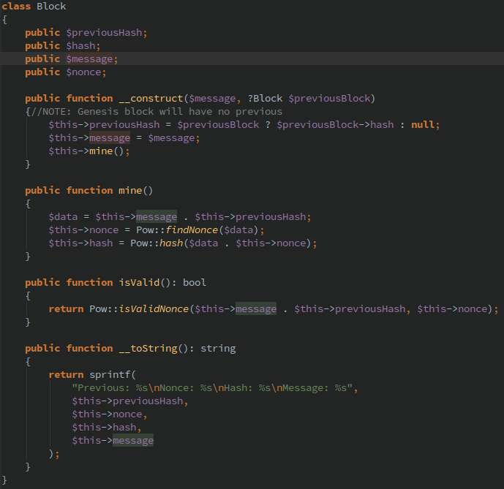
/ElygaCoin/5_blockchain/Block.php

Slide 39
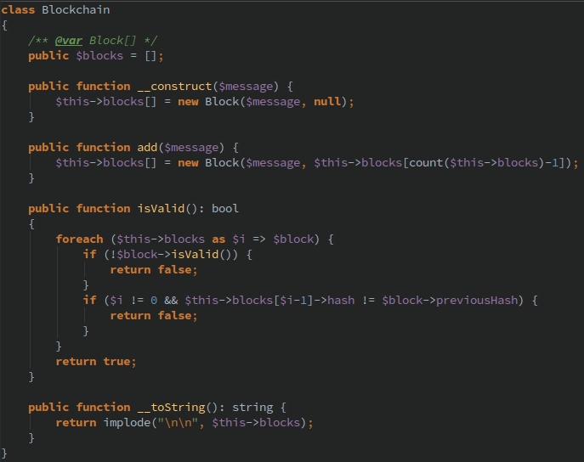
/ElygaCoin/5_blockchain/Blockvhain.php

Slide 40
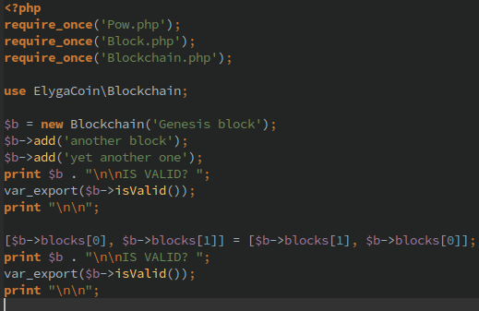
/ElygaCoin/5_blockchain/test_blockchain.php

Slide 41
php test_blockchain.php
$ php test_blockchain.php Previous: Nonce: 861214 Hash: 000000708eaaf8afb9c89ae7b0837b25bdffb2975eee02d56903e4fed888bed2 Message: Genesis block ... IS VALID? true Previous: 000000708eaaf8afb9c89ae7b0837b25bdffb2975eee02d56903e4fed888bed2 Nonce: 1437124 Hash: 000000998d7d5b2df908e3025a00e76433902a9d94bbbd9d0feb2fbe59a9e9c4 Message: another block ... IS VALID? false

Slide 42
/ElygaCoin/6_final/
$ ./gossip.sh Eligijus
$ ./gossip.sh Petras Eligijus
$ ./gossip.sh Jonas Petras
$ ./transfer.sh Eligijus Petras 60 $ ./transfer.sh Petras Jonas 10 $ ./transfer.sh Jonas Eligijus 10

Slide 43
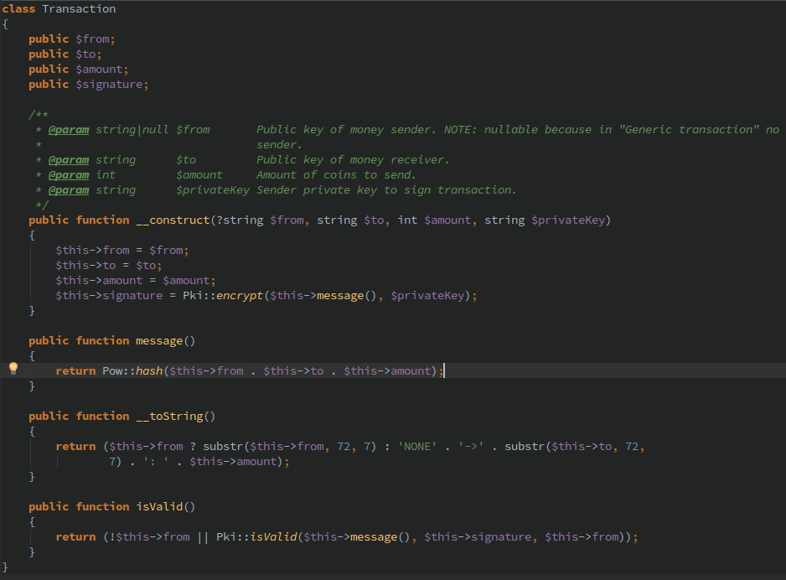
/ElygaCoin/6_final/Transaction.php

Slide 44
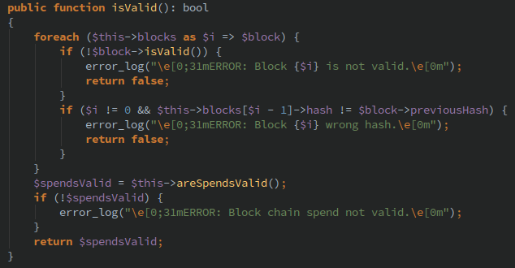
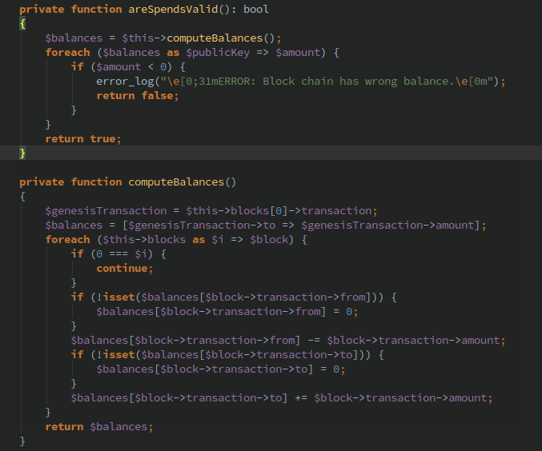
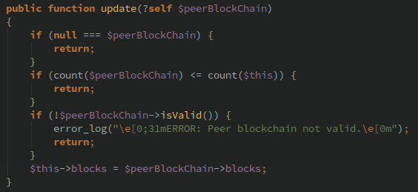
/ElygaCoin/6_final/Blockchain.php

Slide 45
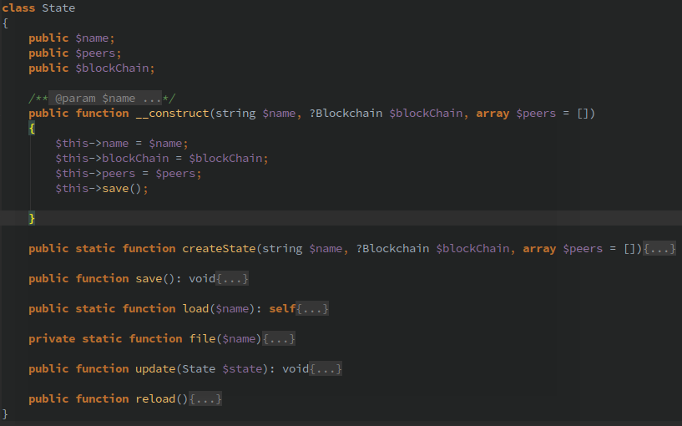
/ElygaCoin/6_final/State.php

Slide 46
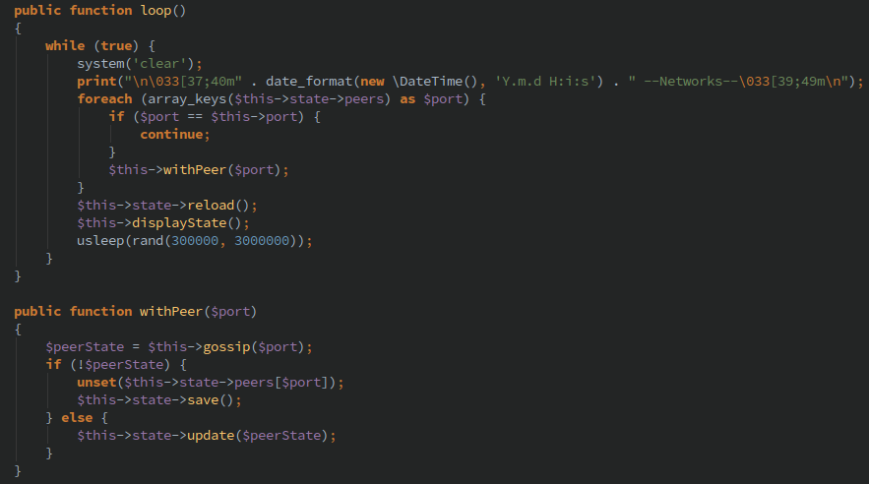
/ElygaCoin/6_final/Gossip.php

Slide 47
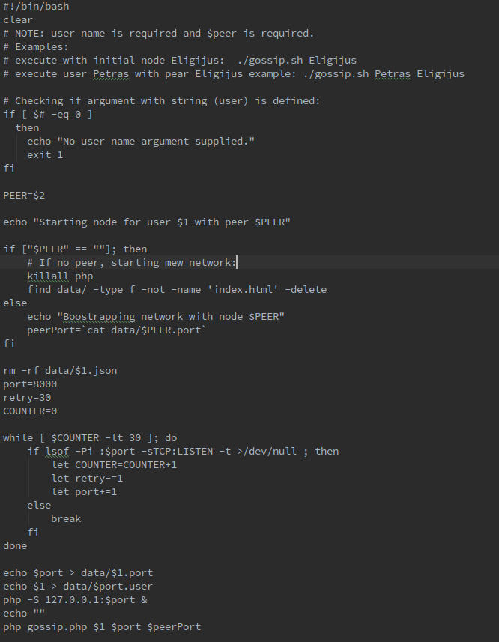
/ElygaCoin/6_final/gossip.sh

Slide 48
/ElygaCoin/6_final/
$ ./gossip.sh Eligijus
$ ./gossip.sh Petras Eligijus
$ ./gossip.sh Jonas Petras
$ ./transfer.sh Eligijus Petras 60 $ ./transfer.sh Petras Jonas 10 $ ./transfer.sh Jonas Eligijus 10

Slide 49
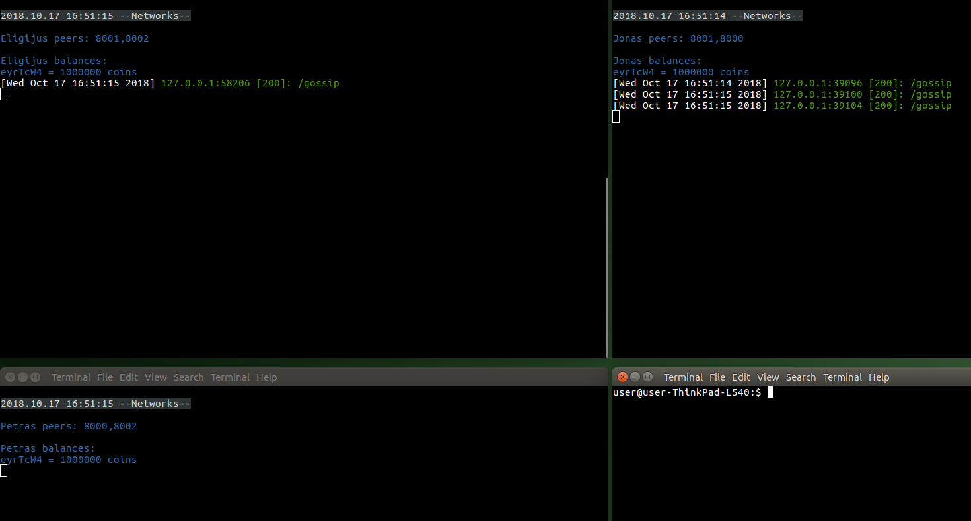
/ElygaCoin/6_final/

Slide 50
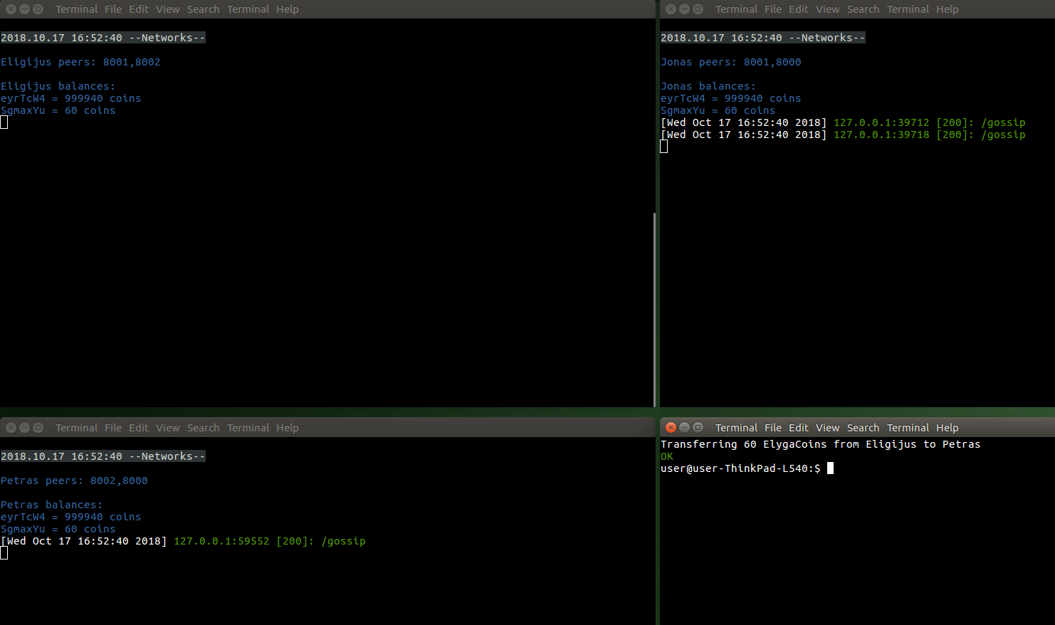
$ ./transfer.sh Eligijus Petras 60

Slide 51
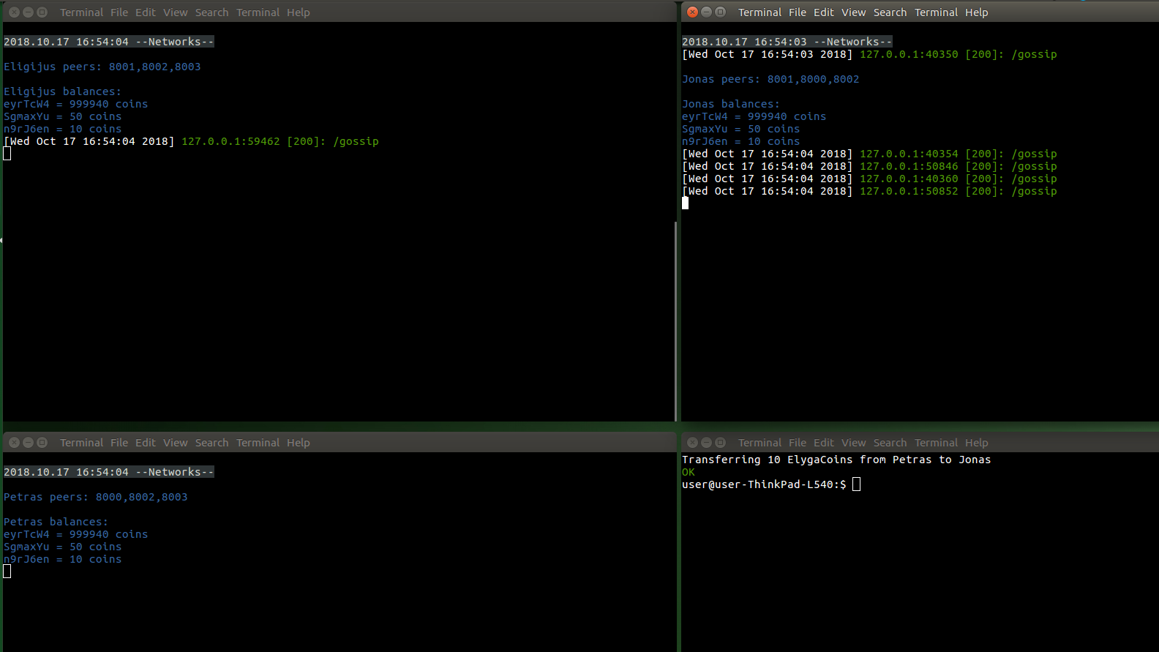
$ ./transfer.sh Petras Jonas 10

Slide 52
Not solved problems
Availability
Authentification
Double-spend
Fork
Light client
Motivation mine
Mining pools
Code in block (Etherium)
Proof-Of-Work
Loose private key

Slide 53
That’s all Folks!
www.stugys.lt

